Slide 1

servers
Notes:
Quick intro to serverless
Maturity model
Wardley map, discussion on utilities
Benefits / ideas about how this changes everything
Adoption ideas
Focus on high value changes
Challenges to implement
Experiences at GameStop

Slide 2
Your business doesn’t have technology problems

Slide 3


Slide 4
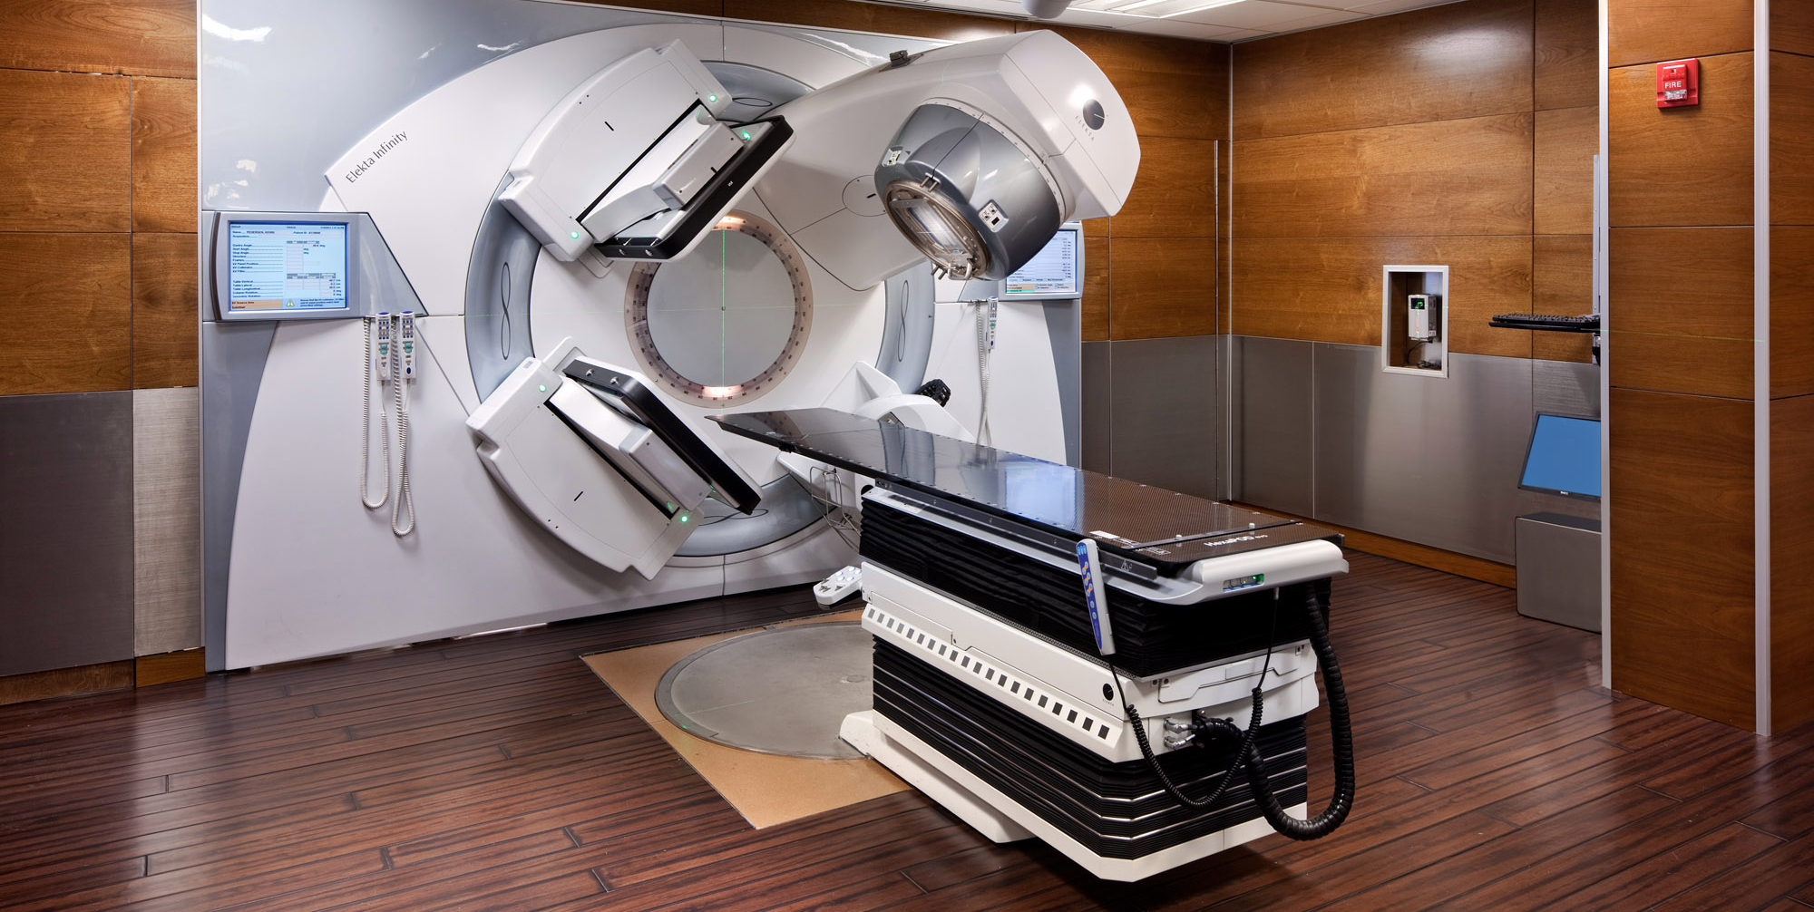

Slide 5
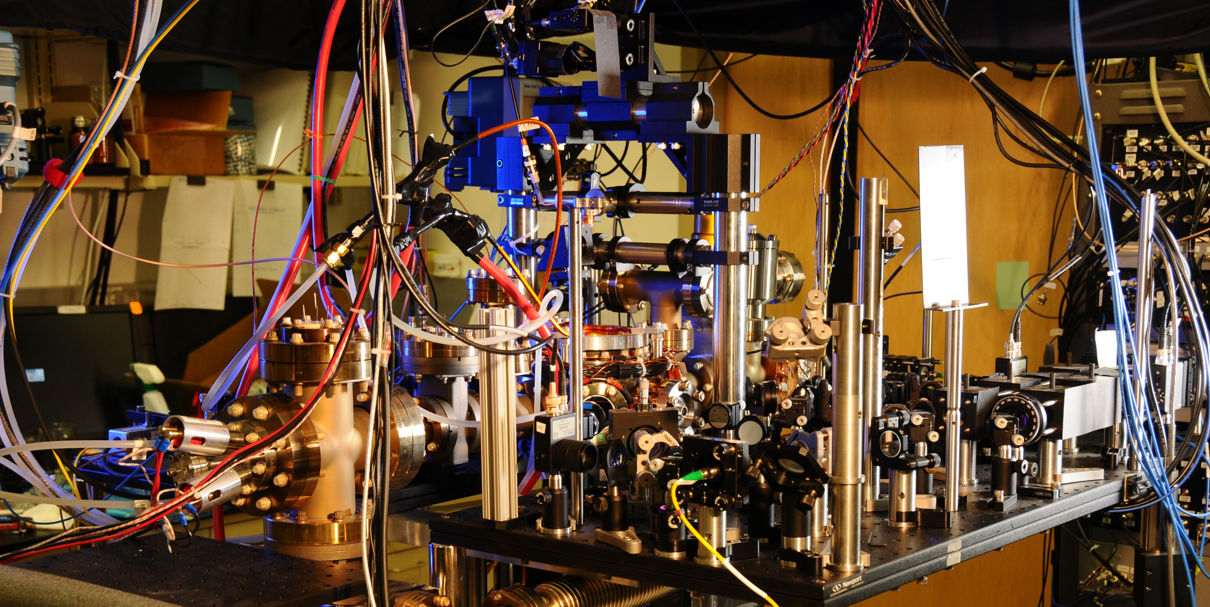
Notes:
Spanner ( Google’s modern relational database management systems that seek to provide the same scalable performance of NoSQL systems for online transaction processing (OLTP) read-write workloads while still maintaining the ACID guarantees of a traditional database system.^{[)1][2][3])}

Slide 6
You don’t have technology problems
Solving technology problems isn’t your business

Slide 7
You still have problems
Notes:
Staying relevant (MySpace) - Facebook
Scaling globally (?)
Reaching new demographics (Netflix launches to 60 countries)
Avoiding political pitfalls
Creating new products/services
Staying price competitive
Adapting to change (Blockbuster)

Slide 8
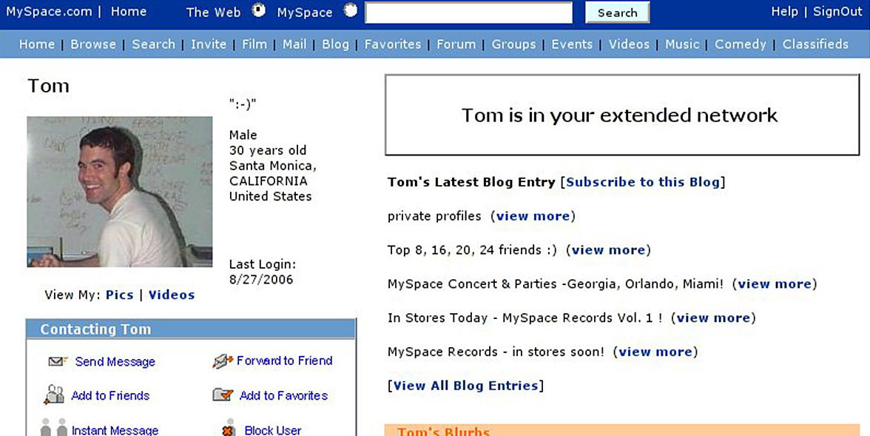

Slide 9


Slide 10


Slide 11
Manager’s/Engineers/CXX’s Agenda
Manager/Engineer/CXX
[Calendar blocks visual] – governance, meetings, reports, reviews
Engineer : Delivery , requirements, test, train, provision, post-mortems
CXX – wondering why no one is focused on the big business problems (how are they spending their time??!)

Slide 12
Workflow analysis report
Job Descriptions -> How time is actually spent

Slide 13
Inject some strategy
Value Chain Mapping
Show size bubble to relate to time/energy savings on how you do IT

Slide 14
-Break-

Slide 15
Quick intro to serverless
Patterns
Framework
AWS

Slide 16
Define what we’re talking about
Serverless as general pattern
Specifically using experience we have with using the Serverless Framework on AWS

Slide 17
Where’s the audience at, and our premise
Maturity framework of DevOps/cloud adoption
Show framework, ask people where they are, we will show how serverless gets you to most mature stage
Makes it easier for you to do all the things you should have done before
Serverless democratizes the DevOps movement
Serverless is the pinnacle of the DevOps movement
We think serverless is the best opportunity for adopting DevOps best practices at your organization

Slide 18
DevOps & cloud best practices maturity model
Metric | I | II | III
Culture | Execute defined processes |  | Learning organization Feedback loops
Organization | Technology & platform teams | Lifecycle teams | Autonomous product lifecycle teams
Projects | Large, cross-team projects Multi-year | Series of small, discrete projects Some cross-cutting | Focus on products Mission-based Autonomy and experimentation Iterative
Data decision making | HiPPO | Structured, schedule reporting Frequently in silos | Data-driven Everyone in organization has access to all data
Delivery | Monthly (+) Manual | Weekly Automated in some environments, for some applications | Multiple times a day Fully automated
Cloud adoption | Exploring the cloud | Moving to the cloud | 100% cloud adoption
Operations | Analyzing to see if something broke |  | Analyzing to see if business value created
Security | Security theater | Firewall security blanket | Publish security practices

Slide 19
Serverless is a commodity
Lets you move yourself up the value chain
Wardley graph included here
(revisit at the end when discussing adoption paths)
Serverless is focusing on the top of the value chain
Lift and shift is focusing on the bottom of the value chain

Slide 20
Customer
Visible
Value chain
Invisible
Manipulate
pictures
Share, view, comment, like pictures
Upload
pictures
App
Platform
Compute
Storage
Data center
Power

Slide 21

Customer
Visible
Value chain
Invisible
 | Genesis | Custom Built | Product / Rental | Commodity + Utility
 | Evolution
Manipulate
pictures
Share, view, comment, like pictures
Upload
pictures
App
Platform
Storage
Compute
Data center
Power

Slide 22
Customer
Visible
Value chain |  |  | s
Invisible
 | Genesis | Custom Built | Product / Rental | Commodity + Utility
 | Evolution
Manipulate
pictures
Share, view, comment, like pictures
Upload
pictures
App
Platform
Compute
Storage
Data center
Power

Slide 23
DevOps best practices
Infrastructure as code
CI/CD for increased speed and stability
Monoliths to microservices to functions
Small teams, highly cohesive and loosely coupled
Only pay for what you use
Polyglot – the right language/framework for the job

Slide 24
Benefits of serverless
True variable cost computing
Time to market goes from months or weeks to days or hours
Built in support for things you should be doing already
Infrastructure as code
API driven development and data analysis to inform product development
Small teams

Slide 25
Serverless as Trojan horse
It’s like magic – haven’t met a developer who didn’t love it
Easy to use, easy to experiment with
Low cost to learn, develop with, experiment with – only cost is time, no infrastructure or hosting

Slide 26
Who should do it
Everyone, but the value will you get is inversely related to the investments you have made in DevOps and the cloud already
For mature DevOps and cloud companies the benefits will be more incremental because they are already following best practices
For companies without strong DevOps or cloud practices the value is much higher

Slide 27
How to try it
If the people you’ve hired have built a mature DevOps and cloud company they already know about serverless and love it, and probably are already using it
If the people you’ve hired haven’t built a mature DevOps and cloud company
If they would like to but can’t for whatever reasons, they likely know about serverless and have used it on side projects and love it
If they aren’t pushing for DevOps or cloud there’s a good chance they don’t know anything about serverless (or DevOps practices in general)
Know the group you are working with

Slide 28
Challenges to implement
Retailers run large off the shelf software packages, how to incorporate serverless models around it

Slide 29
GameStop

Slide 30
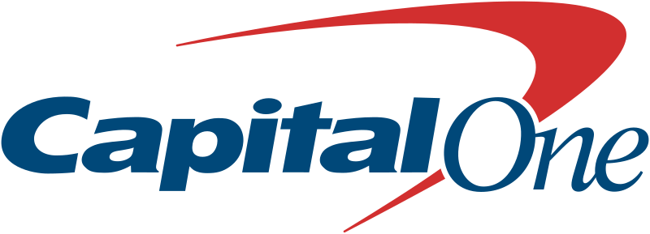






Where it’s already started

